Slide 1
Group 1
Ruben Holthuijsen (1064459)
Sander van Swieten (1063788)
Vince van Doorn (1061669)
Victor de Sousa Gama (0929470)
Kevin Hartman (1044032)
TYPOGRAPH TEST
Group 1
Ruben Holthuijsen (1064459)
Sander van Swieten (1063788)
Vince van Doorn (1061669)
Victor de Sousa Gama (0929470)
Kevin Hartman (1044032)
Group 1
Ruben Holthuijsen (1064459)
Sander van Swieten (1063788)
Vince van Doorn (1061669)
Victor de Sousa Gama (0929470)
Kevin Hartman (1044032)
Group 1
Ruben Holthuijsen (1064459)
Sander van Swieten (1063788)
Vince van Doorn (1061669)
Victor de Sousa Gama (0929470)
Kevin Hartman (1044032)
Group 1
Ruben Holthuijsen (1064459)
Sander van Swieten (1063788)
Vince van Doorn (1061669)
Victor de Sousa Gama (0929470)
Kevin Hartman (1044032)

Slide 2
COLOR PALETTE
#80B4B5
#61A6A2
#E1B7B1
#C87777
#7267A2
#575295
#9AB6DA
#6985BF
#A7C374
#8EAE54

Slide 3
Intentionally left blank

Slide 4
RNA sequencing-based Machine Learning for Detection of
Triple Negative Breast Cancer
Ruben Holthuijsen (1064459) • Sander van Swieten (1063788) • Vince van Doorn (1061669)
Victor de Sousa Gama (0929470) • Kevin Hartman (1044032)

Slide 5
Outline
TODO - Opleuken met icoontjes
Context
Approach
Results
Discussion

Slide 6

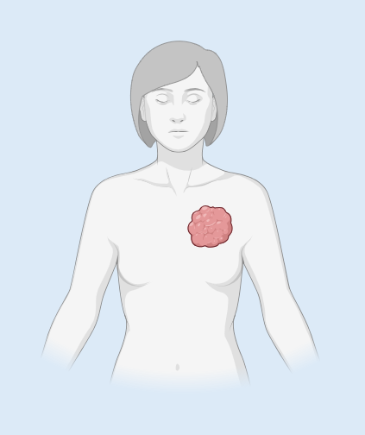





Context
2.300.000 cases of breast cancer worldwide in 2022
TNBC - Overview
Women younger than 40 years of age are highest risk
Triple-Negative Breast Cancer
~10-20% of breast cancer
Triple-Negative Breast Cancer (TNBC)
Breast Cancer
(BC)
ER (ESR1)
/
PGR (PGR)
/
HER2 (ERBB2)
/

Slide 7
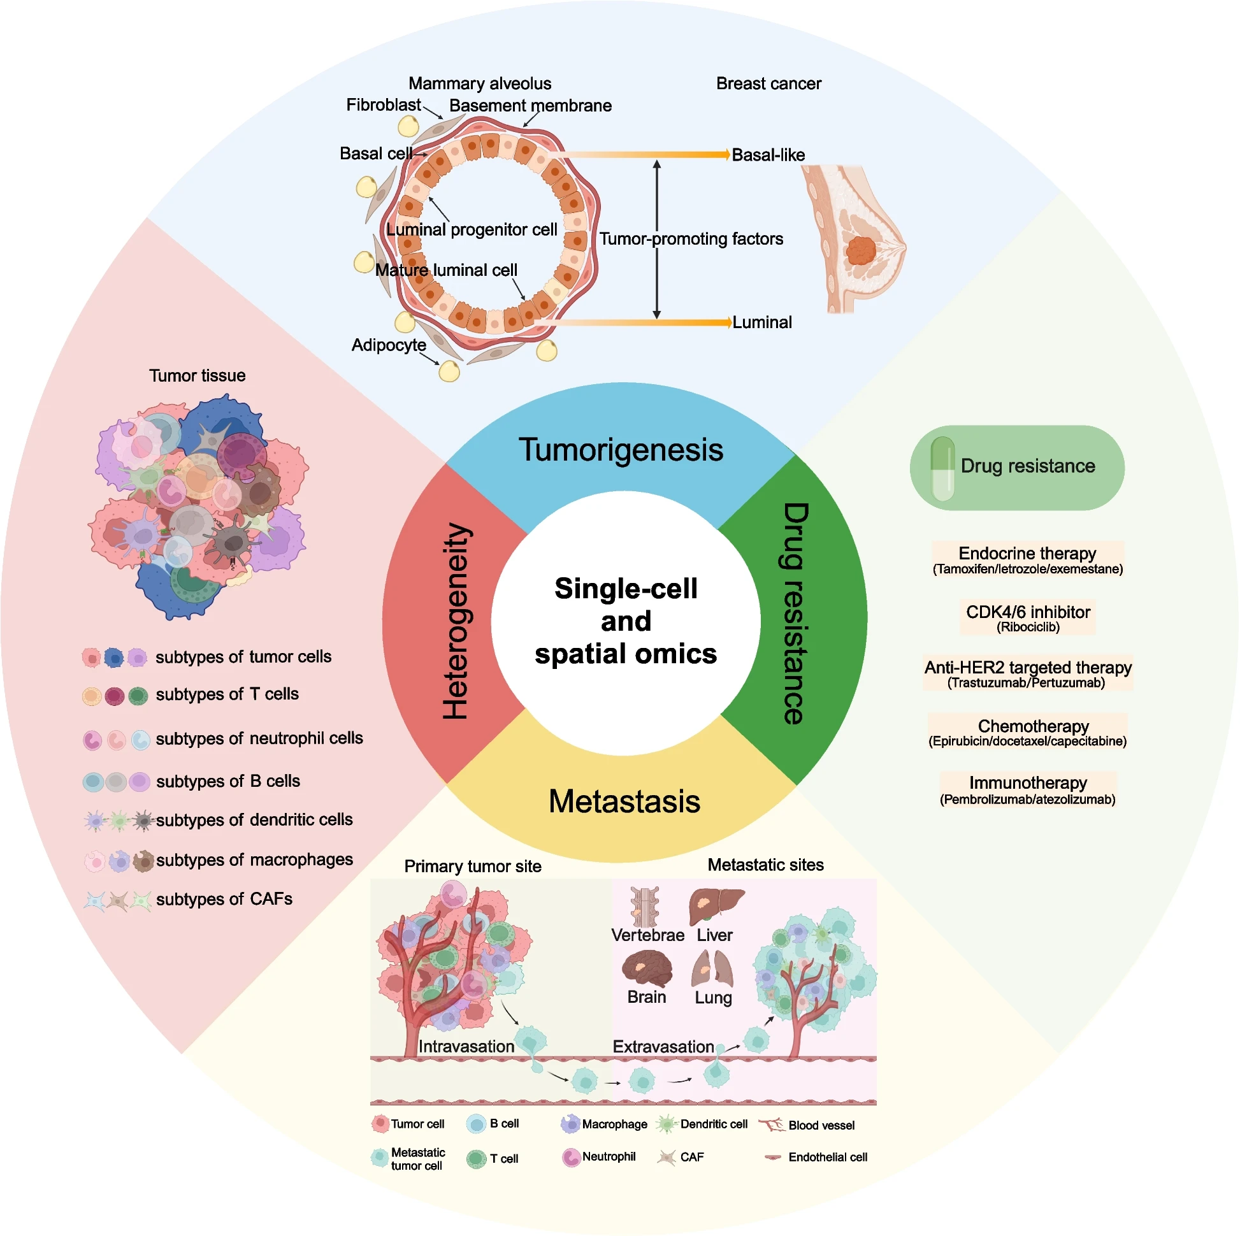
Context
TNBC - Overview
Source:
Xiong et al. Biomarker Research (2024) 12:107
doi 10.1186/s40364-024-00654-1

Slide 8
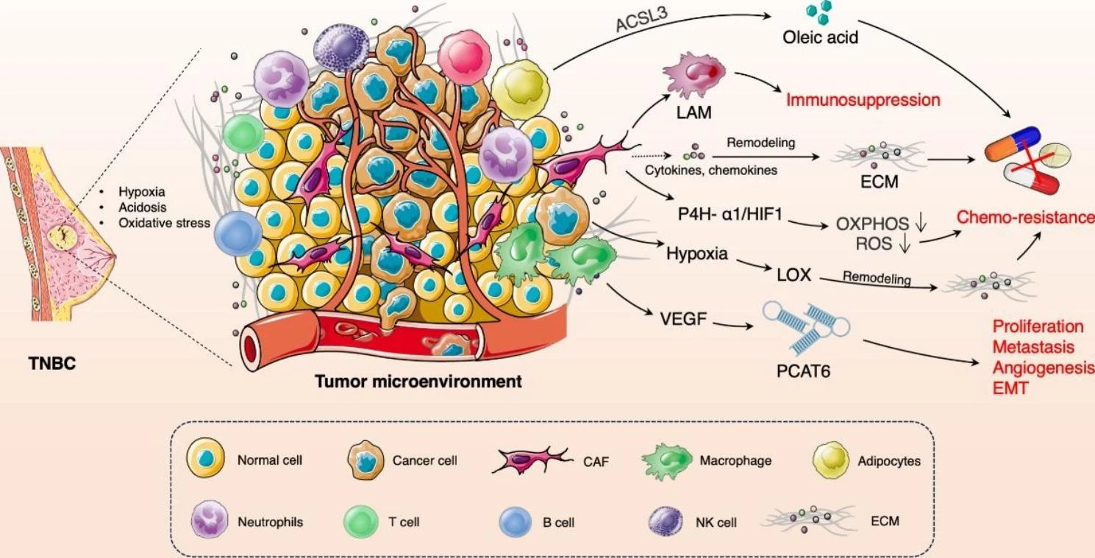
Context
TNBC – Tumor Microenvironment (TME)
Source:
Liu et al. Molecular Cancer (2023) 22:145
doi 10.1186/s12943-023-01850-7

Slide 9
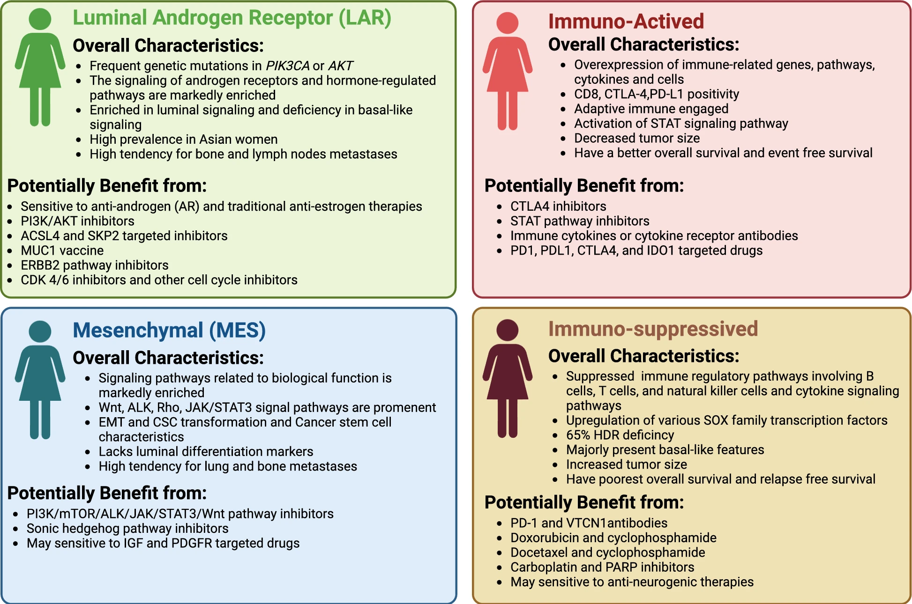
Context
TNBC – Subtyping
Source:
Chen et al. Cell & Bioscience (2025) 15:13
doi 10.1186/s13578-025-01359-0

Slide 10
Approach
Project
TCGA-BRCA
GSE65216
GSE76250
GSE53752
GSE10893
Outlier removal
Imputation
Mean removal
Normalization
Literature:
Output 1 article
Review 65 articles
ML Methods:
PCA
BORUTA
ANOVA
ExtraTree
Statistical
RFE
Logistical regression Support Vector Machine
Random Forest
Classification
TNBC / nTNBC
Dataset
Preprocessing
Feature
selection
Model
Output

Slide 11
Approach
Machine Learning
Missing data
Dimensionality
Imputation
One fifth of the minimum value recorded
KNN
Selection
Quantified in all datasets
Deletion
With near-zero variance
Recursive feature elimination

